Slide 1

Personal Todo Management
CS401 Final Project
Kasim E. Abdu & Kaleab Y. Abebe

Slide 2
Problem description
Customized and minimal todo application that is customized to our needs instead of using applications that has a lot of features we don’t need

Slide 3
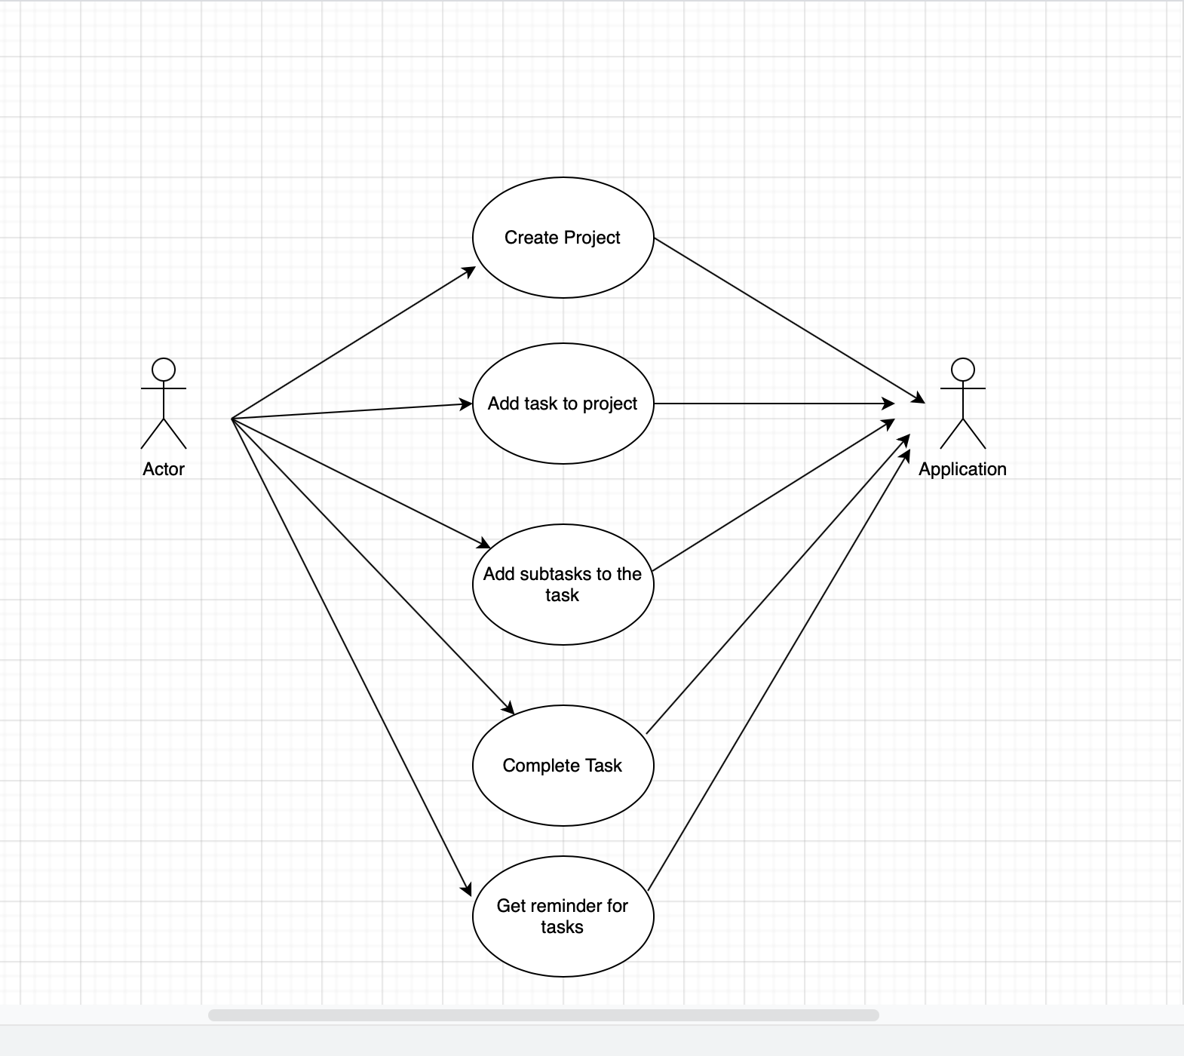
Use cases

Slide 4
Use cases
1. Create project: (Implemented on both Logic feature and UI feature)
User should be able to create project with a desired title and theme color
2. Add task (Implemented on both Logic feature and UI feature)
Users should be able to create tasks, set due date and descriptions for projects.
3. add sub task ( Implemented on Logic feature)
User can add a sub task to an existing task

Slide 5
Use cases
4. Mark task as completed (Implemented on both Logic feature and UI feature)
User can mark tasks completed or unmark it back to incomplete
5. Add Reminder (Partially implemented on logic)
Users can add reminders for tasks.
6. Display status of task (Not implemented)
User can see the status of each tasks from the task due date

Slide 6

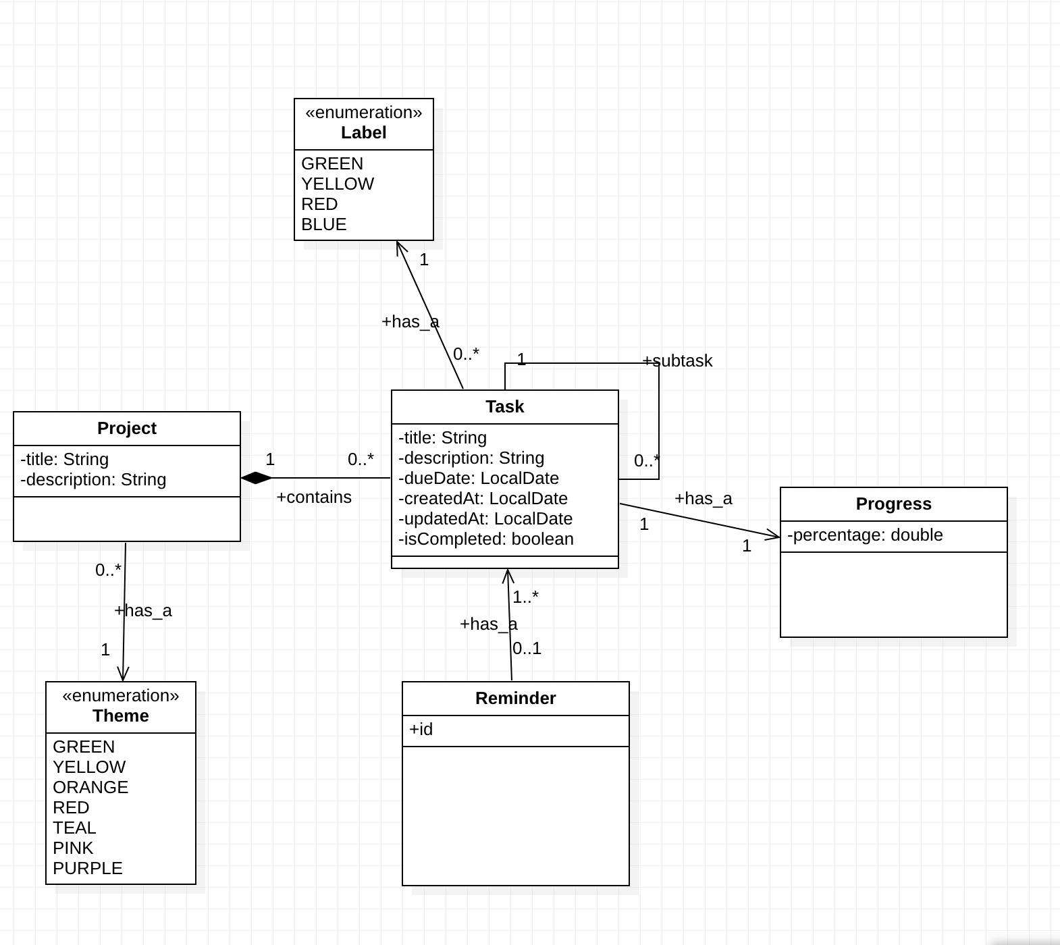

Static Model
z

Slide 7
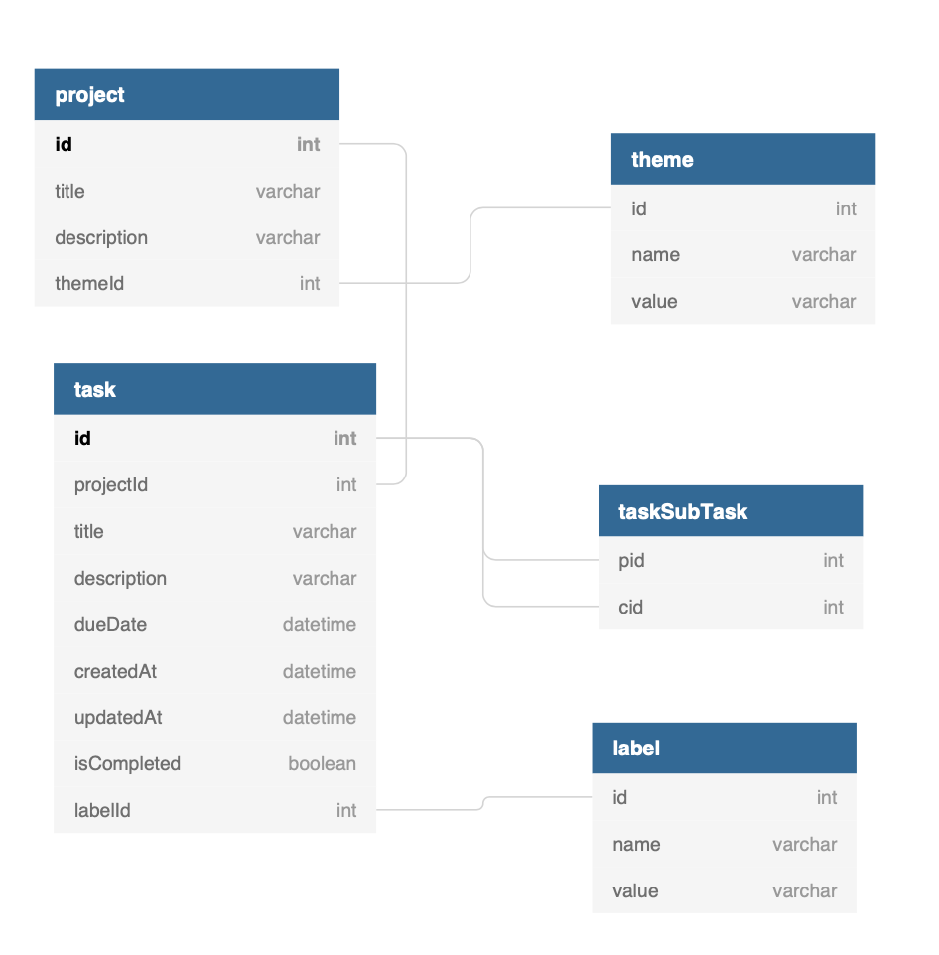
ER Diagram
z

Slide 8
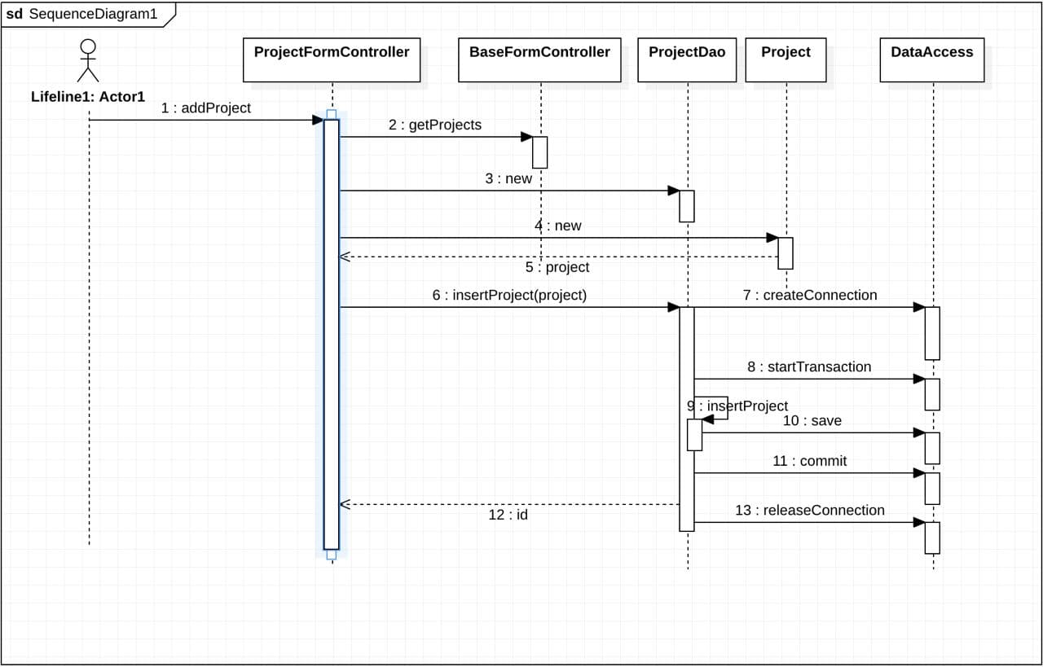
Sequence Diagram
z

Slide 9
Patterns & Principles Used
DAO pattern
MVC
Factory pattern
Streams

Slide 10
Tools and Libraries used
Maven
JavaFx
Mysql
JWT
JDBC
Scene Builder
Eclipce
Github
MS Teams

Slide 11
☺ Thank You! ☺
Demo will continue …
z

